Slide 1

DriverPass
System Analysis
Deyanira Arroyo
Notes:
Hello, I'm Deyanira Arroyo. This presentation explains how the proposed DriverPass system will help customers prepare for their driving tests and help employees manage lessons and records.

Slide 2

System Requirements
What the system does:
• Book and change two-hour lessons
• Show practice tests and progress
What it must provide:
• Secure access for each role
• Phone-friendly access and backups
Notes:
DriverPass needs one place for customers to choose training, reserve two-hour lessons, and see their practice test progress. Staff also need to know which driver and car are assigned. The system should work on a phone or computer and keep information protected and backed up. These requirements come from the DriverPass interview.

Slide 3
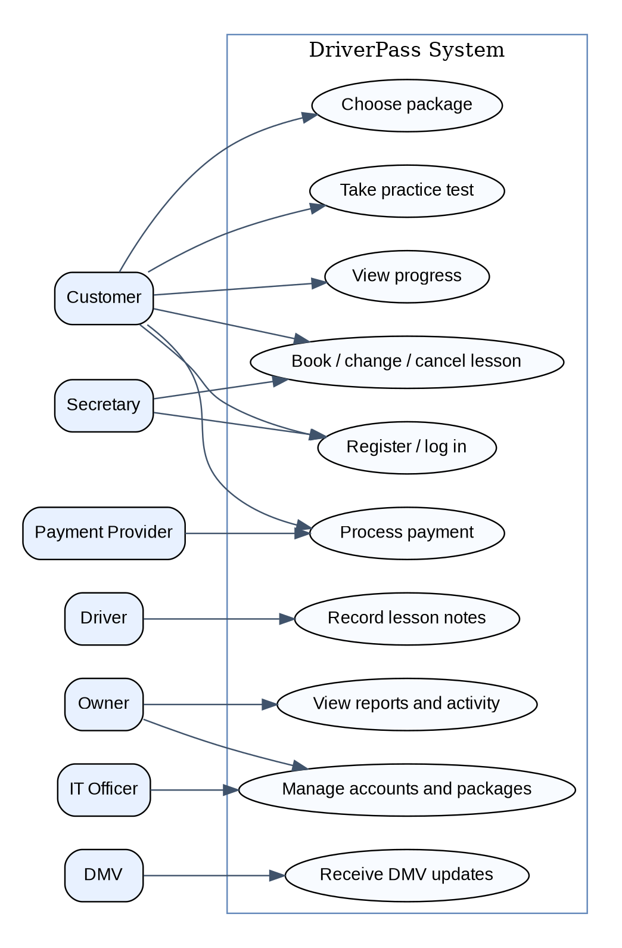
Use Case Diagram
Notes:
This picture shows the people who will use DriverPass. Customers can manage lessons and training. The secretary helps with appointments, drivers leave notes, Liam checks reports, and Ian manages employee access. The DMV and payment service provide information or services from outside DriverPass. This helps everyone understand their responsibilities.

Slide 4
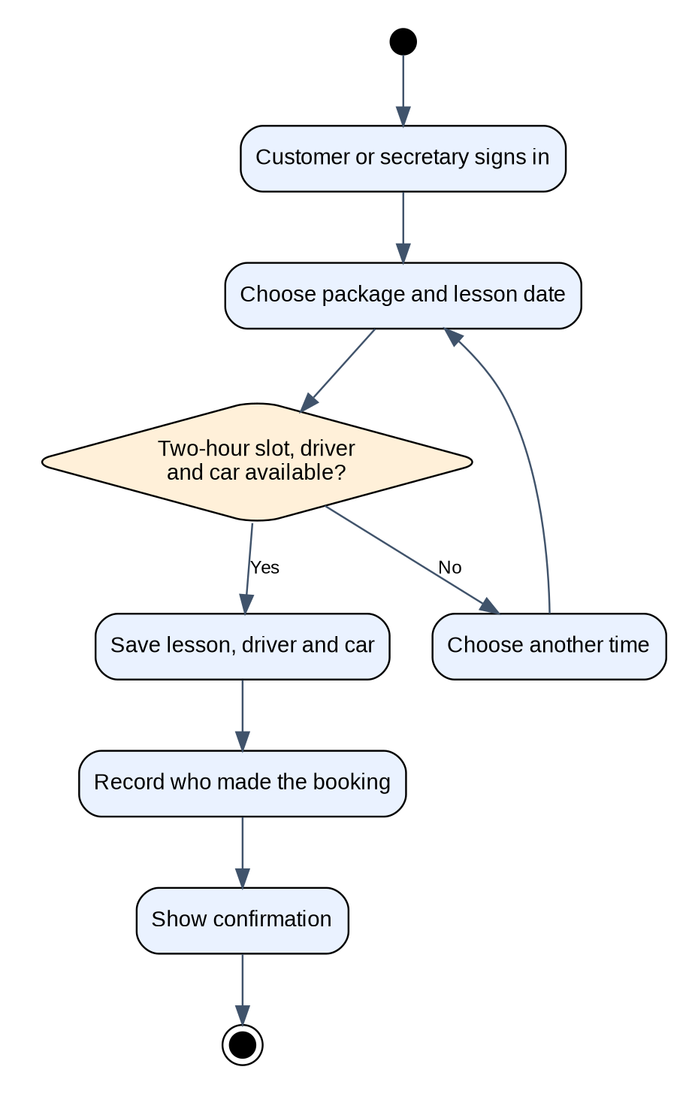
Activity
Diagram
Notes:
This diagram follows a customer or secretary booking a lesson. First, they sign in and choose a package and time. The system checks that a driver and car are both free for the two-hour lesson. If not, the person chooses another time. When everything is available, it saves the reservation and records who made it. This helps prevent double bookings and makes changes easier to trace.

Slide 5
Security
• Accounts have different access levels
• Passwords and online data are protected
• Booking changes are recorded
• Cloud backups support recovery
• Payment details use a secure provider
Notes:
Security matters because DriverPass will hold contact details, lesson records, and payment-related information. People will only see what their role allows. Passwords and online connections will be protected, changes to bookings will be recorded, and cloud backups will help recover information. A payment provider should handle card details securely instead of DriverPass storing card security codes.

Slide 6
System Limitations
• Changes require an internet connection
• Lessons depend on driver and car availability
• DMV updates depend on available information
• New training modules need future development
Notes:
There are a few limits to understand. Customers need an internet connection to make changes, even though reports can be downloaded for offline viewing. The system can only offer a lesson when a driver and car are free. DMV updates depend on access to current DMV information. Staff can disable existing packages, but adding brand-new training modules would require a later update. These limits keep the first version realistic.

